Slide 1
EmoSense: Exploring Textual Emotions using Multi-Model Analysis with K-fold Cross Validation and Feature Engineering.
Group Members:
20101026 Faiaz Mohammad Tiham
20101360 Gazi Md. Julcarnine
20101512 Ehsan Abdullah Khan Saad
20101611 Nihad Adnan Shah Tirtho
20101053 Hossain Mohmamed Usman
Faculty: Annajiat Alim Rasel
S.T : Sadiul Arefin Rafi
R.A : Humaion Kabir Mehedi

Slide 2
Introduction
Understanding Emotions within Text: Why It Matters.
How EmoSense works
The EmoSense framework aims to explore textual emotions using multi-model analysis.
Enhancing Human Interaction Through EmoSense
Understanding textual emotions is crucial in various fields, such as healthcare, marketing, customer service, and mental health support.

Slide 3
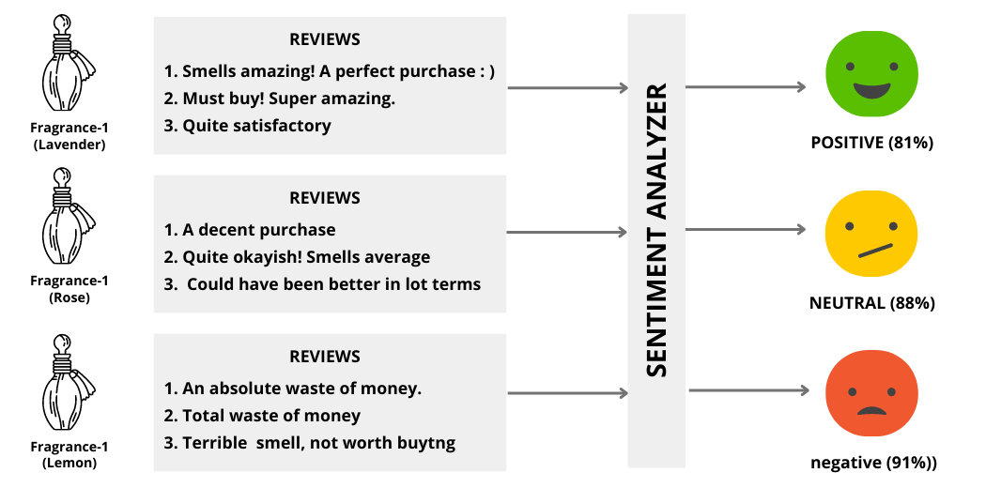
Example:
.

Slide 4
Dataset Description
The dataset employed in this study consists of 40,000 instances, each characterized by a unique tweet ID, associated sentiment label, and corresponding textual content.
The sentiment labels cover a spectrum of emotional expressions, ranging from "empty" to sentiments like "sadness" and "enthusiasm."
The dataset is structured in a tabular format with 40,000 rows and 3 columns, with some missing values in the sentiment attribute.

Slide 5
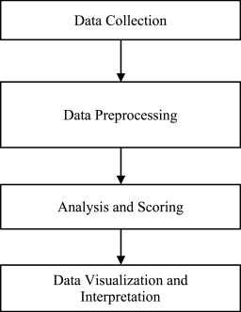
Methodology Overview
The EmoSense framework follows a systematic methodology, including data collection, preprocessing, feature engineering, model selection, K-fold cross-validation, and performance evaluation.
Transparency and reproducibility are emphasized throughout the methodology, with detailed documentation of dataset sources, preprocessing steps, feature engineering techniques, and model configurations.

Slide 6
Feature Engineering
Feature engineering plays a crucial role in the EmoSense framework, as it involves transforming the raw textual content into meaningful features that capture the emotional content.
Various techniques, such as SelectKBest, Particle Swarm Optimization (PSO), Maximum Relevance Minimum Redundancy (mRMR), Boruta, and RELIEFF, are explored for feature extraction.

Slide 7
Model Selection
EmoSense employs a suite of machine learning models, including Support Vector Machines (SVM), Random Forests, and Naive Bayes.
The choice of models depends on the dataset and the specific requirements of the emotion analysis task.
Model hyperparameters are tuned to optimize performance.
The models are evaluated using several metrics tailored to emotion analysis tasks, including accuracy, precision, recall, F1-score, and confusion matrices.
The choice of evaluation metrics aligns with the research objectives and the nature of the dataset.
The results of the evaluation highlight the effectiveness of EmoSense in achieving heightened accuracy and depth of emotion classification.

Slide 8
K-fold Cross-Validation
K-fold cross-validation is a reliable method for evaluating model performance.
The dataset is divided into 5 equally sized folds, with K-1 folds used for training and the remaining fold used for testing.
This process is repeated 5 times, with each fold used exactly once for testing.
The results are then averaged across the 5 iterations to obtain a more accurate estimate of the model's performance.
K-fold cross-validation helps to ensure that the model is not overfitting to the training data and can generalize well to new data.
In EmoSense, K-fold cross-validation is used in conjunction with feature engineering and multiple models to achieve better accuracy and depth of emotion classification.

Slide 9
Performance Evaluation
Model performance is evaluated using several metrics tailored to emotion analysis tasks, including accuracy, precision, recall, F1-score, and confusion matrices.
The choice of evaluation metrics aligns with the research objectives and the nature of the dataset.
Throughout the methodology, transparency and reproducibility are emphasized.
Detailed documentation of dataset sources, preprocessing steps, feature engineering techniques, and model configurations is essential for future researchers to replicate and build upon the EmoSense framework

Slide 10
Results and Analysis
EmoSense is a pioneering approach to emotion recognition from text that amalgamates Random Forest, Naive Bayes, and Support Vector Machine models.
The models were evaluated on a meticulously curated dataset, coupled with systematic feature engineering and K-fold cross-validation.
EmoSense achieved an average accuracy rate of approximately 60% for SVM, 35.57% for Random Forest, and 53.7% for Naive Bayes.
The results highlight the effectiveness of EmoSense in achieving heightened accuracy and depth of emotion classification.
The choice of evaluation metrics aligns with the research objectives and the nature of the dataset.
Transparency and reproducibility are emphasized throughout the methodology, with detailed documentation of dataset sources, preprocessing steps, feature engineering techniques, and model configurations.
The insights gained from the exploration of textual emotions shed light on the performance of the selected models and the impact of feature engineering.

Slide 11
Implications and Future Research
EmoSense has the potential to increase our knowledge of how machine-learning techniques can be used to interpret the complex web of human emotions in text.
EmoSense can be used to acquire insights into the mental structures of textual data by creating models that can effectively recognize and categorize emotions.
EmoSense can set the ground for the creation of intelligent systems that can offer more context-aware responses and interventions.
EmoSense has implications for a range of industries, including marketing, customer service, and mental health support, among others. - Future research can explore the use of EmoSense in other domains, such as social media analysis, political discourse analysis, and sentiment analysis in other languages.
Future research can also investigate the use of EmoSense in conjunction with other modalities, such as audio and video, to achieve more comprehensive emotion analysis.
The development of more sophisticated feature engineering techniques and machine learning models can further enhance the accuracy and depth of emotion classification achieved by EmoSense.

Slide 12
References
[1] B. Agarwal and N. Mittal, ”Machine Learning Approach for Sentiment
Analysis,” in Prominent Feature Extraction for Sentiment Analysis, SocioAffective Computing, Springer, Cham, 2016.
[2] M. S. Neethu and R. Rajasree, ”Sentiment analysis in twitter using
machine learning techniques,” in 2013 Fourth International Conference
on Computing, Communications and Networking Technologies (ICCCNT),
Tiruchengode, India, 2013, pp. 1-5. doi: 10.1109/ICCCNT.2013.6726818.
[3] F. A. Acheampong, C. Wenyu, and H. Nunoo-Mensah, ”Text-based
emotion detection: Advances, challenges, and opportunities,” Engineering
Reports, vol. 2, p. e12189, 2020.
[4] K. Shrivastava, S. Kumar, and D. K. Jain, ”An effective approach
for emotion detection in multimedia text data using sequence based
convolutional neural network,” Multimedia Tools and Applications, vol.
78, pp. 29607-29639, 2019.
[5] N. Alswaidan and M. E. B. Menai, ”A survey of state-of-the-art approaches for emotion recognition in text,” Knowledge and Information
Systems, vol. 62, pp. 2937-2987, 2020.
[6] A. Majeed, H. Mujtab, and M. O. Beg, ”Emotion detection in Roman
Urdu text using machine learning: Proceedings of the 35th IEEE/ACM
International Conference on Automated Software Engineering,” 2020, pp.
125-130.
[7] S. Aleem, N. ul Huda, R. Amin, S. Khalid, S. S. Alshamrani, and
A. Alshehri, ”Machine Learning Algorithms for Depression: Diagnosis,
Insights, and Research Directions,” Electronics, vol. 11, no. 7, p. 1111,
2022.
[8] A. H. Saffar, T. K. Mann, and B. Ofoghi, ”Textual emotion detection in
health: Advances and applications,” Journal of Biomedical Informatics,
vol. 137, p. 104258, 2023.
[9] B. Desmet and V. Hoste, ”Emotion detection in suicide notes,” Expert
Systems with Applications, vol. 40, no. 16, pp. 6351-6358, 2013. doi:
10.1016/j.eswa.2013.05.050.

